Slide 1
BRASS Scenario 7a
F-35 Testers Wrap up Weapons Delivery Accuracy Tests
Adapted from a flight test that occurred in 2017 in F-35 Lightning flight testing at China Lake, CA

Slide 2
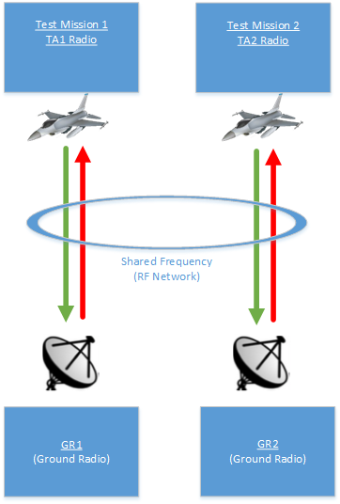
Scenario #7a – Brief Description
This scenario describes a situation that involves two test articles initially sharing the same frequency for their missions. Suddenly, TA1 is grounded and leaves the other aircraft (TA2) with more bandwidth for the next 30 minutes.
The goal is for the airborne aircraft (TA2) to take advantage of the extra bandwidth to conduct more tests.

Slide 3
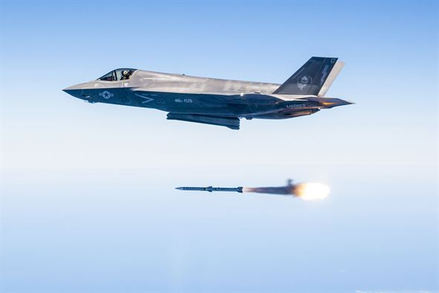
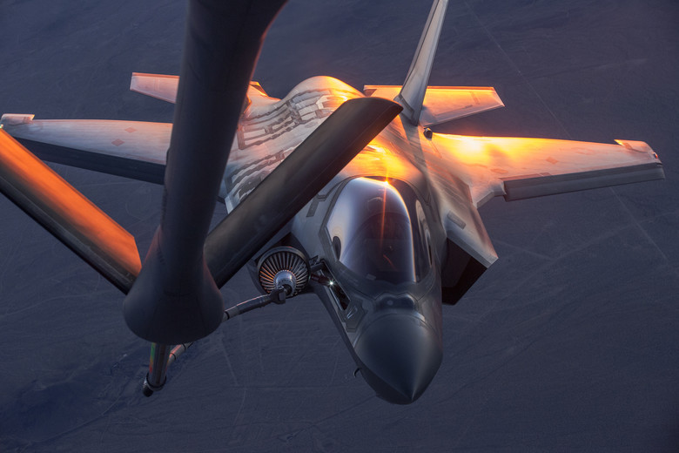
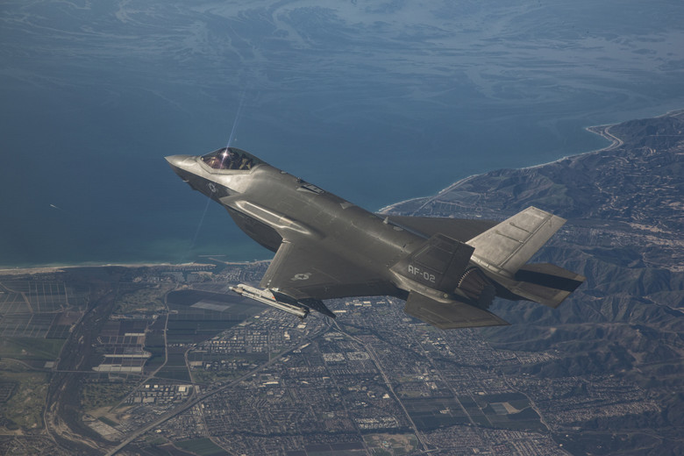
Test Article
Aircraft: F-35
“Each weapon test required multiple missions including software development, “dry runs” and then the actual weapon release. Not including the gun, Hamilton said the F-35 ITF delivered 55 weapons during WDA testing, which was mainly done over the military sea range off the California coast and at Naval Air Weapons Station China Lake in California.”
http://www.hill.af.mil/News/Article-Display/Article/1400908/f-35-testers-wrap-up-weapons-delivery-accuracy-tests/

Slide 4
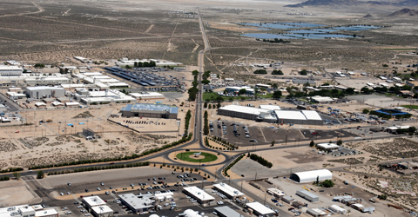
Range Infrastructure
Range Network:
Naval Air Weapons Station at China Lake, CA
Equipment Used:
Ground Station Tracking Antenna and related network infrastructure
MCR processing live data
Equipment Available:
All in use
“NAWS China Lake is located in the Western Mojave Desert region of California, approximately 150 miles north of Los Angeles. The installation is the Navy's largest single landholding, representing 85 percent of the Navy’s land for RDAT&E use and 38 percent of the Navy’s land holdings worldwide. In total, its two ranges and main site cover more than 1.1 million acres, an area larger than the state of Rhode Island.”
https://www.cnic.navy.mil/regions/cnrsw/installations/naws_china_lake.html

Slide 5
Flight Test Operation Flow

Slide 6
Static Scheduling
This mission depicts a scenario whose radios have transmission schedules pre-defined via MDL
There is no LM in this scenario
System Manager reconfigures radio(s) to modify link utilization limitations in order to achieve desired QoS guarantees
Updated MDL file(s) to modify transmission schedules
Updated MDL file(s) to modify QoS policies per link

Slide 7
Requirements
Voice and Safety-of-Flight need to be our critical data
MDL provides static schedules
Bandwidth available: 10 Mb/s
TA1/GR1 test mission is allocated 5 Mb/s
TA2/GR2 test mission is allocated 5 Mb/s
When TA1 is grounded, then TA2 and GR2 will need to be reconfigured to reallocate all bandwidth to the TA2/GR2 test mission.
Latency requirement – 100 ms

Slide 8
Test Mission Description in MDL
QoSPolicies: Describe the high-level mission-specific data delivery requirements and constraints that will be provided by the Radio Access Network for a given test mission
RadioLinks: Describe the configuration parameters for any Radio Links associated with this test mission
Networks: Describes the physical topology of TA1, TA2 and Ground networks; Describes how everything is connected as well as performance capabilities
RANConfiguration: Describes the set of basic parameters for a Radio Access Network

Slide 9
Network Load Sharing Before Adaptation
TA1/GR1 is allocated 5 Mb/s bandwidth – combined uplink and downlink configuration
Voice: 150Kb/s (75Kb/s downlink and 75Kb/s uplink)
Safety: 250Kb/s (250Kb/s downlink and 0Kb/s uplink)
Bulk: 4,500Kb/s (4,000Kb/s downlink and 500Kb/s uplink)

Slide 10
GR1/TA1 Uplink and Downlink Voice Traffic Before Adaptation
The rate in the QueueConstruct specifies the rate for that SLP
Ground Radio to TA1 - Uplink Voice Traffic: 75Kb/s
TA1 to Ground Radio - Downlink Voice Traffic: 75Kb/s

Slide 11
GR1/TA1 Uplink and Downlink Safety Traffic Before Adaptation
The rate in the QueueConstruct specifies the rate for that SLP
Ground Radio to TA1 - Uplink Safety Traffic is irrelevant
This traffic is from air to ground only
TA1 to Ground Radio - Downlink Safety Traffic: 250Kb/s

Slide 12
GR1/TA1 Uplink and Downlink Bulk Traffic Before Adaptation
The rate in the QueueConstruct specifies the rate for that SLP
Ground Radio to TA1 - Uplink Bulk Traffic: 500Kb/s
TA1 to Ground Radio - Downlink Bulk Traffic: 4,000Kb/s

Slide 13
Similar for GR2/TA2 Uplink and Downlink
TA2/GR2 are also using 5 Mb/s combined bandwidth (for simplicity, TA2 is using a symmetric use of the network loads)
Voice: 150Kb/s (75Kb/s downlink and 75Kb/s uplink) → critical data
Safety: 250Kb/s (250Kb/s downlink and 0Kb/s uplink) → critical data for downlink
Bulk: 4,500Kb/s (4,000Kb/s downlink and 500Kb/s uplink)

Slide 14
GR2/TA2 Uplink and Downlink Voice Traffic Before Adaptation
The rate in the QueueConstruct specifies the rate for that SLP
Ground Radio to TA2 - Uplink Voice Traffic: 75Kb/s
TA2 to Ground Radio - Downlink Voice Traffic: 75Kb/s

Slide 15
GR2/TA2 Uplink and Downlink Safety Traffic Before Adaptation
The rate in the QueueConstruct specifies the rate for that SLP
Ground Radio to TA2 - Uplink Safety Traffic is not applicable; this traffic is from air to ground only
TA2 to Ground Radio - Downlink Safety Traffic: 250Kb/s

Slide 16
GR2/TA2 Uplink and Downlink Bulk Traffic Before Adaptation
The rate in the QueueConstruct specifies the rate for that SLP
Ground Radio to TA2 - Uplink Bulk Traffic: 500Kb/s
TA1 to Ground Radio - Downlink Bulk Traffic: 4,000Kb/s

Slide 17
Radio Link Description in MDL
Describes the one way downlink radio link connection between the TA1 radio and the Ground Radio Group 1
Describes the one way uplink radio link connection between the Ground Radio and TA1 Radio Group
Describes the one way downlink radio link connection between the TA2 to the Ground Radio Group 2
Describes the one way uplink radio link connection between the Ground Radio and TA2 Radio Group
Notes:
<EpochSize>100</EpochSize> in RANConfiguration (per seconds 1000 divide by epoch size)
5 minutes = 300 seconds = 300 * EpochSize = 3,000
2 sec = 2 * EpochSize = 20

Slide 18
Network Description in MDL
Description of TA1 network which includes the Radio component “TA_RadioComponent1”
Description of TA2 network which includes the Radio component “TA_RadioComponent1”
Description of ground network which includes two Radio components, “RAN_GroundRadio1” and “RAN_GroundRadio2”

Slide 19
After TA1 is Grounded
Bandwidth available to TA2/GR2: 10 Mb/s
Because of the additional bandwidth available, TA2 can perform different tests that have greater minimum data requirements
TA2/GR2 will need to be reconfigured to use the entire available bandwidth of 10 Mb/s
System Manager has the role to reconfigure both TA2 and GR2 radios to adapt

Slide 20
Network Load Sharing Adaptation
TA2/GR2 are allocated 10 Mb/s bandwidth (combined)
Voice: 150Kb/s (75Kb/s downlink and 75Kb/s uplink)
No changes
Safety: 600Kb/s (600Kb/s downlink and 0Kb/s uplink)
New test points require additional Safety-of-Flight data
Bulk: 9,000Kb/s (8,000Kb/s downlink and 1,000Kb/s uplink)
We want to bring more data down to take advantage of the bandwidth

Slide 21
GR/TA2 Uplink and Downlink Voice Traffic Adaptation
The rate in the QueueConstruct specifies the rate for that SLP
Ground Radio to TA2 - Uplink Voice Traffic: 75Kb/s
TA2 to Ground Radio - Downlink Voice Traffic: 75Kb/s

Slide 22
GR/TA2 Uplink and Downlink Safety Traffic Adaptation
The rate in the QueueConstruct specifies the rate for that SLP
Ground Radio to TA1 - Uplink Safety Traffic is irrelevant
This traffic is from air to ground only
TA1 to Ground Radio - Downlink Safety Traffic: 600Kb/s

Slide 23
GR/TA2 Uplink and Downlink Bulk Traffic Adaptation
The rate in the QueueConstruct specifies the rate for that SLP
Ground Radio to TA2 - Uplink Bulk Traffic: 1,000Kb/s
TA2 to Ground Radio - Downlink Bulk Traffic: 8,000Kb/s

